Slide 1

PDEG ACCOMPLISHMENT REPORT
COVERED PERIOD: 2020 to Present (September 12, 2023)

Slide 2


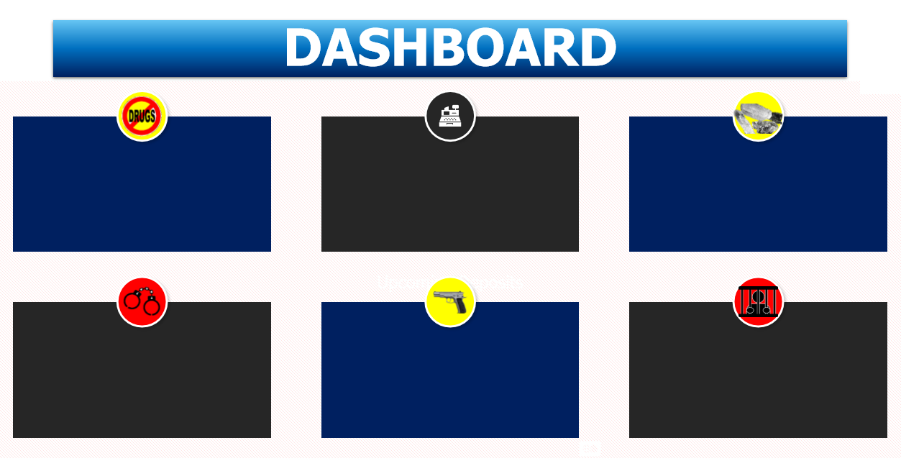
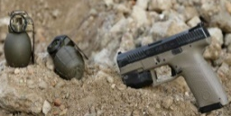

ACCOMPLISHMENT REPORT
Period Covered: January 1, 2023 to September 12, 2023
Buy Bust | Search Warrant | Warrant of Arrest | Marijuana Eradication | Recovery/Discovery | Total
126 | 22 | 389 | 20 | 2 | 559
1. The number of Drug Cases in the Philippines 2. The Profile Demographic of Drug Cases 3. Percentage of Adolescents Using Drugs 4. Active Drug Cases in Quezon Province 5. Active Drug Rehabilitation in Quezon Philippines
646
Drug
Personalities
Arrested
2
DIPOs
559
Operations Conducted
10
Firearms
Confiscated
251,468,072.00
Total Estimated Standard Drug Price
(Php)
ILLEGAL DRUGS CONFISCATED
Shabu (grams) | Marijuana Plants (pieces) | Marijuana Dried Leaves (grams) | Marijuana Kush (grams) | Marijuana Stalks (grams)
7,936.57 | 963,160 | 22,815.80 | 1,003 | 5,000

Slide 3
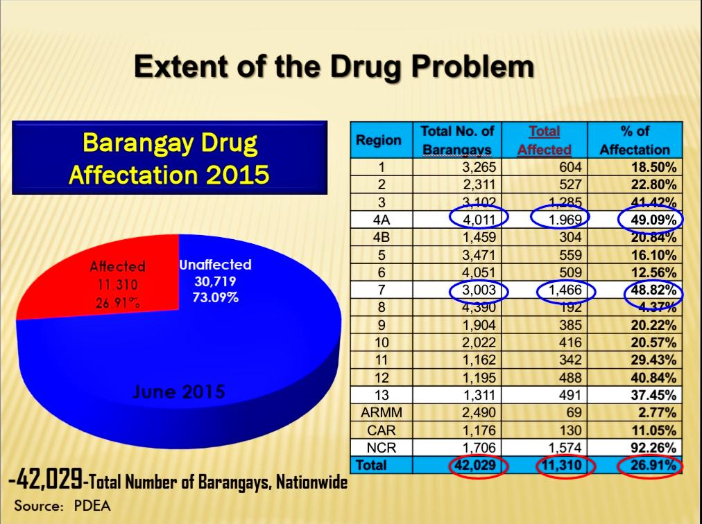
1. The number of Drug Cases in the Philippines 2. The Profile Demographic of Drug Cases 3. Percentage of Adolescents Using Drugs 4. Active Drug Cases in Quezon Province 5. Active Drug Rehabilitation in Quezon Philippines
Notes:
Profile demogradic drug cases

Slide 4
75% of adolescents using drugs

Slide 5
5 Barangays in Quezon province declared drug free .

